Slide 1
基于核心素养的
英语一轮复习备考策略

Slide 2
主要内容
一、高考的命题理念
二、2023年高考命题评析
三、英语教学和备考中存在的问题
四、2024年高考英语备考建议
五、复习课教学案例分享

Slide 3
一、高考的命题理念
中国高考评价体系梳理了各要素之间的逻辑关系，遵循正确的研究方向、目标和科学的路径、方法，创造性地提出高考命题理念从“知识立意”“能力立意”转向“价值引领、素养导向、能力为重、知识为基” 。中国高考评价体系是一个以价值为引领的、系统的、科学的、创新的评价体系，有助于在高考的各项工作中切实落实立德树人的根本任务。

Slide 4
高考评价体系聚焦“关键能力”和“思维品质”的考查，有助于将学生从传统的对知识的简单占有中解放出来，引导学生强化关键能力、学科素养和创新思维的培养培育，推动高水平创新人才自主培养。
基于“考思维”、“考能力”的命题理念，传统的教学模式、学习方法、课程结构、课程内容、课程实施方式、课程评价及课程管理模式都将发生根本性的变化，实现从教师传授知识向学生主动学习的转变，课堂教学将实现从“授人以鱼”到“授人以渔”的转变，启发式教学、体验式教学、参与式学习、小组合作学习等成为更有效的教学教育模式。随着高考内容和命题改革的不断深入，高中教学将逐步实现从“以知识传授为中心”到“以关键能力和核心素养培养为中心”的转变。

Slide 5
高考评价体系科学服务选才，实现高考由“考知识”向“考能力”的转变。
突出对关键能力和学科素养的考查，探索“价值引领、素养导向、能力为重、知识为基”的综合考查模式，不断增强试题的灵活性、开放性、探究性和创新性，试题命制考查的重点集中在学生的思维品质和综合运用所学知识发现问题、分析问题以及解决问题的能力，强调思维过程和思维方式，鼓励学生多角度主动思考、深入探究，发现新问题、找到新规律，降低“死记硬背”和“机械刷题”的收益。

Slide 6
高考评价体系有效引导教学，充分发挥高考指挥棒的正向指挥作用，积极引导高中教育教学，形成“招-考-教-学”良性互动，引导教学回归课标、回归课堂。
高考命题严格依据高中课程标准，确保“内容不超范围、深度不超要求”。考查内容限定在课程标准范围之内，既注重考查内容的全面性，又突出主干和重点内容的考查，引导中学依照课程标准进行教学。高考命题遵循教育规律，注重考查对基础知识、基本技能、基本方法的深刻理解，引导学生要知其然，更知其所以然，学有所思、思有所疑、疑有所问、问有所悟，以考促教，服务教学提质增效。

Slide 7
2023年1月，由中国高考报告学术委员会编撰的2023年度高考蓝皮书《中国高考报告（2023）》由新华出版社出版，从七个部分讨论了2022年中国高考改革的政策背景、命题特征、教学改革、招录情况、社会影响和评价体系，系统讨论高考综合改革下的政策走向及应对策略。
《报告》指出，通过对近三年的高考试题分析发现，信息识别与加工、逻辑推理与论证、科学探究与思维建模、语言组织与表达、独立思考与质疑（提出问题、开放作答、合理论证）、批判性思维等关键能力已经成为高考考查的重点，这充分表明以批判性思维为代表的关键能力已经成为高考命题的主要方向和要求。

Slide 8
高考英语科的功能定位
以高考评价体系的“一核”为指引，明确英语科考试的功能定位：第一，英语科命题必须坚持立德树人，促进学生形成开放意识和合作精神，促进学生养成独立思考和自主学习的习惯，促进学生提高多视角思辨能力和跨文化交际能力，最终引导学生实现全面而有个性的发展；第二，英语科命题必须以高等学校人才选拔的要求为依据，科学设计试题内容，考查学生的核心价值、学科素养、关键能力和必备知识，为高等学校选拔基础扎实、善于应用、综合素质高并具有创新潜力的人才；第三，英语科命题必须以国家课程标准的内容为依据，努力发挥积极导向作用，引导中学英语教学落实《英语课程标准》的要求，助力发展素质教育。
——陈康、吴泓霖、李新煜、乔辉《基于高考评价体系的英语科考试内容改革实施路径》2019

Slide 9
新课标高考命题思路
一是突出立德树人，把社会主义核心价值观和中华优秀传统文化考出来；
二是突出主干知识，把课堂表现考出来；
三是突出学科思想和方法，把实践能力考出来；
四是突出学生特点，把创新精神考出来。

Slide 10
2023高考英语试卷分类
全国乙卷：河南、江西、宁夏、新疆、内蒙古、青海、陕西、甘肃（8）
全国甲卷：四川、广西、西藏、贵州（4）
新高考Ⅰ卷：福建、湖南、湖北、河北、江苏、山东、广东 浙江 安徽山西（10）
新高考Ⅱ卷：海南、重庆、辽宁 黑龙江 吉林 云南（6）
自主命题：北京、天津、上海、（3）

Slide 11
高考英语命题规律：新高考卷&全国卷
题型 | 新高考卷 | 全国卷
听力 | 20小题（每小题1.5分；满分30分） | 20小题（每小题1.5分；满分30分）
阅读理解 | 15小题（每小题2.5分；满分37.5分） | 15小题（每小题2分；满分30分）
七选五阅读 | 5小题（每小题2.5分；满分12.5分） | 5小题（每小题2分；满分10分）
完形填空 | 15小题（每小题1分；满分15分） | 20小题（每小题1.5分；满分30分）
语法填空 | 10小题（每小题1.5分；满分15分） | 10小题（每小题1.5分；满分15分）
短文改错 | 无 | 10处错误（每处错误1分；满分10分）
书面表达 | 第一节 应用文写作（满分15分） 第二节 读后续写（满分25分） | 应用文（满分25分）

Slide 12
二、2023年高考试题评析
（一）坚持立德树人，引导学生全面发展
1.聚焦铸魂育人，落实核心素养考查
2.引导体美劳教育，夯实全面发展基础
3.讲好中国故事，增强学生文化自信
（二）坚持教考衔接，考查学科关键能力
1.强调基础扎实，突出关键能力考查
2.优化情境设计，重视思维品质培养

Slide 13
2023年高考命题的突出特点
2023年高考英语命题依据高校人才选拔要求和普通高中英语课程标准，按照“方向是核心，平稳是关键”的原则，结合中学英语教学和备考实际，坚持落实立徳树人根本任务，引导学生德智体美劳全面发展，在深化基础性考查的同时，突出关键能力考查，发挥高考的育人功能和积极导向作用。

Slide 14
一、坚持立德树人 引导学生全面发展
1.聚焦铸魂育人，落实核心素养考查
2023年高考英语试卷通过选择特定主题的语篇，落实核心素养考查，引导学生养成喜爱读书、善于求知的学习习惯，培育自尊自爱、自信自强的思维品质，倡导爱护自然、热衷环保的生态理念。
新课标Ⅱ卷阅读C篇介绍一本名为《阅读艺术：书籍爱好者的艺术》；全国甲卷阅读C篇讲述作者畅游于哲学书籍阅读的海洋，说明哲学对现实生活的指导意义。这些语篇引导学生重视书籍阅读和知识的积累，丰富学识，积淀文化底蕴。新课标Ⅰ卷七选五阅读介绍如何学会适度自我原谅；全国甲卷七选五阅读讲述如何成为更有耐心的人。这些语篇引导学生养成自尊、自爱、自信的心理素质，积极乐观地看待自己、善待他人。新高考1卷的B篇介绍具有污水净化功能的生态设计、接触自然有益于人们生活的实验研究、甲卷C篇关于美国灰熊数量增加带来的问题、全国乙卷7选5室内植物为养植人们带来健康的好处引导学生关注自然和周围环境，培养保护和改善生态环境的意识。

Slide 15
2.引导体美劳教育，夯实全面发展基础
2023年高考英语试卷围绕人与自然、人与社会、人与自我三大主题选材，合理设计考查内容、考查要求和考查情境，体现高考对体育、美育和劳动教育的引导。
在体育方面，全国乙卷完形填空题讲述美国体操运动员Gabby Douglas在华人教练的培训下，经过刻苦努力最终获得奥运会个人全能冠军的故事；新课标Ⅰ卷完形填空讲述一名越野赛跑运动员在比赛中将受伤的运动员背至终点就医的故事。这些语篇旨在引导学生关注体育与身心健康，提高运动意识，在体育锻炼中锤炼意志，涵养体育精神。在美育方面，全国甲卷听力部分选取音乐家Maxim谈论其担任柴可夫斯基公开赛裁判的经历的材料；全国乙卷阅读部分选取一位摄影爱好者如何拍摄出高质量风景照片的语篇；新课标Ⅱ卷七选五阅读为学习绘画的朋友提出一些建议。这些语篇旨在引导学生加深对艺术的认识，培养健康向上的审美情趣。在劳动教育方面，全国甲卷阅读介绍一位擅长DIY的人的生活经历。新课标Ⅱ卷B篇介绍学校开设的劳动课程、老师带领学生养花种菜的经历及其对学生身心健康产生积极影响，旨在引导学生形成热爱劳动的观念，在实践中养成劳动意识和劳动习惯。

Slide 16
3.讲好中国故事，增强学生文化自信
2023年高考英语试卷所选语篇弘扬爱国主义，通过融入中华优秀传统文化和社会主义先进文化，引导学生坚定理想信念、增强文化自信。
全国甲卷书面表达题设置的情境是，学校举办以用英文讲中国故事为主题的征文活动，要求考生以一位中国历史人物为题写一篇短文投稿；全国乙卷语法填空题语篇讲述首都北京悠久的城市历史，主张城市发展建设一定要尊重传统、保存好城市的珍贵遗产。新课标Ⅰ卷语法填空题语篇讲述中华美食小笼包的美妙滋味与制作知识。试题中还提及中国历史上的女医生、华人体操教练、大熊猫等中国元素及相关知识。这些语篇和情境通过用英语讲述中国古代和现代的故事，向世界展示中华文明和体现中国精神的优秀文化，同时以浸润的方式引导学生传承和弘扬中华优秀传统文化，增强文化自信和价值观自信，厚植爱国主义情怀。

Slide 17
二、坚持教考衔接 考查学科关键能力
1.强调基础扎实，突出关键能力考查
2023年高考英语试卷对接高中英语课程标准要求，强调对基础语言知识的理解和掌握，注重考查学科关键能力，引导中学英语教学进一步提高教学质量。
试卷在真实、地道的英语语境中考查基础语言知识和文化知识。直接考查基础语言知识的题型包括完形填空、语法填空、短文改错等。这些题型要求考生在正确理解语篇主旨大意的基础上，关注具体语境中不同词语、句子与整个篇章结构之间的联系，考查考生对英语词法、句法以及语篇知识的掌握运用。听力、阅读不直接考查语言知识，但强调语言知识的综合运用。深入考查基础语言知识旨在引导中学教学依据课程标准，帮助学生掌握语音、词汇、语法、语篇和语用等基础语言知识，了解基础文化知识；引导学生深入学习和理解语篇所表达的主题意义，养成一定的语言意识和英语语感。
试卷突出学科关键能力考查，尤其强化对阅读理解和书面表达等关键能力的考查。阅读理解部分要求考生读懂选自英语原版书籍、报纸和杂志（含网络版）中关于一般性话题的简短文段及公告、说明、广告等，并能从中获取相关信息。写作部分强调对书面表达能力的考查，要求考生准确使用语法和词汇，运用一定句型清楚、连贯地表达自己的意见。注重学科关键能力考查旨在引导学生通过听、说、读、看、写等不同的英语学习方式和实践活动，灵活运用所学语言知识，协同发展学科关键能力。

Slide 18
2.优化情境设计，重视思维品质培养
2023年高考英语试卷在听力、阅读、语言运用和写作各部分根据所选素材创设不同的情境，通过增强试题开放性和灵活性考查考生运用语言的能力。
试卷进一优化写作等试题的考查形式。除了写邮件外，写作部分还设置了根据提纲要点写短文等形式。全国甲卷写作情境是，学校举办以用英文讲中国故事为主题的征文活动，要求考生以一位中国历史人物为题写一篇短文投稿；全国乙卷要求考生以向学校英文报投稿的方式用英语描述学习一项新技能的经历及从中获得的体验和感受；新课标I卷应用文写作是外教准备将学生随机分为两人一组，让大家课后练习口语，要求考生给外教写邮件说明这样分组存在的问题,并提出建议；新课标卷读后续写素材讲述一名英语为第二语言的中学生在老师的鼓励下参加写作比赛并通过努力取得优异成绩的故事，要求考生根据给定情节续写两段内容。这些精心设计的试题情境使写作形式更加灵活，内容更加开放，在加强语言表达能力考查的同时，强调对应用性和创造性能力的考查，引导学生在语言学习过程中注重辨析语言和文化中的具体现象，梳理和概括信息，从自己的视角正确评判周围事物和不同观念，创造性地表达自己的观点和想法。

Slide 19
三、英语教学和备考中存在的问题
碎片化教学 注重词汇背默 基础词汇知识的训练
缺少帮助学生内化语言和培养学生思维品质的活动
对语篇教学不够重视 本文解读不到位 写作方法和技巧
缺少系统的写作方法指导和训练

Slide 20
阅读教学中的问题
在当前的英语教学中，有些教师过渡重视语言知识教学，忽略语篇知识和语用能力培养，老师们把很多时间和精力放在字词句教学上，碎片化教学的做法不利于培养学生的高级思维能力，没有为写作提供有力的帮助。
What: What message is conveyed in the passage?
Why: Why does the author write the passage?
How: How is the text organized? How does the author make his point clear?

Slide 21
写作教学中的问题
老师写作方法和写作技巧的缺乏系统的指导，学生没有掌握写作方法。
英语写作教学篇章结构和谋篇布局 英语写作课=汉语翻译
对字词句和复杂结构关注多 过度关注句式升级
学生在书写上花费很多时间和精力
书写漂亮，内容较差 ， 句式复杂 ，表达生硬，行文不流畅，
写得较多，逻辑性差，

Slide 22
英语读后续写存在的问题
1.续写的故事情节不合理。2.对原文理解不全面，遗漏原文中的关键信息。3.续写内容与原文的写作风格不一致。4.续写内容与所给的段落首句不衔接。5.续写中出现较多的语法错误和汉语式的表达。6. 续写的内容丰富性和完整性不够，语言生硬，表达牵强，苍白无力，传递的信息太少。
写作是为了传递信息和表达思想，续写的语言表达的质量和语法错误的数量决定了学生得分的档次。这些错误严重影响续写部分的语言表达的质量，降低了写作的档次，因而导致失分。
大量的考生在写作中使用相同或相近的词汇、短语、句型甚至句子，造成千人一面的现象。尽管没有出现考生套用写作模板的情况，但句群和句子层面的“套用”现象非常普遍。由于考生对所背诵的词语、句子和段落“食而不化”，续写中出现了各种低级的语言错误，导致失分。

Slide 23
四、2024年高考英语备考建议

Slide 24
(一)英语一轮复习的基本目标
基础能力过关（一轮复习的主要目的）。
重点补不会的知识点。
最好能制订详细的计划。
高考英语在重视基础知识的同时，突出考查语言运用能力，形成了以篇章阅读为主体的试题布局。因此，高三第一轮复习的过程不应只是对已学知识的简单重复和强化，而是一个再学习、再认识、提高理解能力和运用能力的过程，应侧重于形成系统的、完整的英语知识体系，打牢基础，最终目的是提高语言运用能力。因此，作为指导学生复习的英语教师，必须有一套行之有效的应对策略，以缓解学生的压力，减轻学生的负担，确保在有限的时间内提高学生的英语综合素质和备考能力。

Slide 25
（二）英语一轮复习备考的进度安排
时间 | 关键词 | 重要时间节点 | 复习内容 | 复习形式 | 课堂模式
2023.7-2023.8 | 课本为主，打好基础 | 1. 暑假作业 2. 一轮复习 | 必修和选择性必修共7本教材单词和语法知识+新课标3500单词和短语及1500个扩充词汇。 *开展英语词汇训练，以单元模块及语法专题为单位，全面细致地将新课标中的单词、短语、句型结构及语法专项的知识内容进行全面系统的梳理，精讲精练，扫除知识盲点。 | 以新教材、新课标词汇表为依据，将高考词汇分为写作词汇和阅读词汇两大类：写作词汇要求会写会用，要求学生注重常用词的拼写和熟词生义；阅读词汇要求学生具有认知能力，坚持每天课上听写，快速检测学生对阅读词汇的掌握情况。学习+复习+运用，突出高考的重点、难点和热点。 词汇复习从穿插在早自习进行，到渗透在每一节课的教学中。 | 检测性复习→找问题→提炼学习要点→精讲习题（讲题时，把高一、高二学习阶段比较零碎的语言点进行梳理，形成知识网络）→巩固练习（近3年高考真题及经典试题）→总结反省（寻找差距和分析错误原因）
2023.9-2023.10 | 心态调整，侧重细节 | 1. 开学摸底考试 2. 9月月考 3. 民航、空军招飞 4. 期中考试 5. 国庆假期
2023.11-2023.12 | 错题归纳，增大题量 | 1. 11月月考 2. 艺考政策 3. 民航招飞 4. 高考报名 5. 特殊类招生 6. 12月月考
2024.1-2024.2 | 深度理解，寒假备考 | 1. 期末考试 2. 高考考试说明 3. 寒假 4. 开启二轮复习

Slide 26
（三）英语一轮复习备考的策略
1.重视教材
教材的单词、短语、经典句型要背熟，固定用法要掌握。
2.多积累，以翻译为主，语法不要抠太细
（1）零碎时间背词汇、短语，理解它们在句子中如何运用。
（2）多翻译小短文，理解文章大意，熟读经典段落。
3.熟练掌握英语基础知识，为提高英语运用能力做准备
（1）根据文章背景判断语法的运用。
（2）训练从记忆基础知识到正确答题的能力。

Slide 27
4. 不追求速度，切忌囫囵吞枣
（1）扎实不会的知识点；
（2）以点带面，系统梳理和关联。
5. 研究历年真题
(1)了解真题怎么考，设哪些陷阱，考点有哪些变化；
(2)反复研究错误或正确的原因；
(3)掌握正确的答题规律。

Slide 28
一轮复习与整体复习目标分解
总的来说，一轮复习重在基础，二轮复习重在提升，三轮复习重在强化。同一类别目标在不同的复习阶段，从操作层面看大致可以做以下的分工：
目标类别 | 知识 | 能力 | 运用 | 分析 | 综合 | 表达
一轮复习 | 梳理 | 分类 | 考点 | 细化 | 模式 | 基础
二轮复习 | 结构 | 语感 | 技能 | 层次 | 逻辑 | 创新
三轮复习 | 整合 | 思维 | 规律 | 系统 | 思路 | 规范
建议：目标和分工明确，循序渐进，沉静总结，不急于求成。

Slide 29
教材内容与应试练习
2022年高考真题语篇 | 相关教材语篇（新人教版）
乙卷书面表达：英语学习方式 | 必修一：Unit 5 Languages Around the World
乙卷短文改错：绿色出行 | 必修一：Unit 3 Sports and Fitness
新高考I卷阅读理解C篇：关爱老人的传统 | 必修三：Unit 2 Morals and Virtues
新高考I卷阅读理解D篇：语音与农业生产 | 必修一：Unit 5 Languages Around the World
新高考I卷七选五：健身搭档促进健身 | 选择性必修三：Unit 2 Healthy Lifestyle
新高考I卷完形填空：露营经历 | 选择性必修三 ：Unit 4 Adversity and Courage
新高考I卷语法填空：大熊猫国家公园 | 必修二：Unit 2 Wildlife Protection
建议：回归教材，重视教材，重视课堂教学。

Slide 30
学校课程与个人计划
学校课程：
知识的建构和练习具有系统性、全面性，复习的进度和教学计划具有一定经验，符合复习规律，同伴学习的相互合作与比较能及时让自己调整和改进。
个人计划：
自己学习的漏洞和问题更有针对性、有效性，复习的时空条件具有灵活性。
建议：知识框架不宜过多，注意“点面”结合，弥补自己的“真漏洞”。

Slide 31
英语一轮复习备考策略和建议
（一）如何拓展基础词汇？
注重词汇情境中的应用，在句子中、在语篇中学习词汇
核心词汇的拓展: 构词法 同根词、类转此、熟词生义
1.拼写易错词、识别相似词
2.重点词汇的词性转变
3.盲点单词
4.动词过去式过去分词的双写
5.固定搭配(动词短语、介词短语、形容词短语等)
6.教材没有课标有的单词7.有必要想扩充的词汇

Slide 32
英语词汇复习策略
重点词汇的复习坚持“词不离句，句不离文”原则
基础词汇要变形和拓展
核心词汇词汇要记词组、短语、句式
写作时，尽量尝试使用所学词汇
把单词和短语放在句中记忆 learn by doing

Slide 33
核心词汇的变形
unfortunately
adv. 不幸地; 令人遗憾地
unluckily不幸地
fortunately
adj. 幸运地
luckily幸运地
unfortunate
adj. 不幸的;可惜的; 令人遗憾的
unlucky不幸的
fortunate
adj. 幸运的; 吉利的; 交好运的
lucky 幸运的
fortune
n. 财富; 机会，运气; 大笔的钱命
luck 运气
misfortune
n. 不幸; 厄运; 不幸的事故

Slide 34
选词填空一
fortune fortunate fortunately misfortune unfortunate unfortunately
Luckily/
Fortunately
1. _________, everything worked out all right in the end.
2. The artist died in poverty in 1947, but his art is worth a _______.
3. David managed to escape, but the others were not so ____________.
4. You are not the only person to have suffered _________in your life.
5. I intended to arrive here an hour ago, but __________I missed the train.
6. It was very __________ that the power went out during the movie.
fortune
fortunate/lucky
misfortune
unfortunately/unluckily
unfortunate

Slide 35
选词填空二
succeed success successful successfully unsuccessful unsuccessfully
1. It is reported that the experiment was a big ________.
2. Scientists claim they ______________in finding a cure for cancer so far.
3. As a businessman, Arthur has been highly _________.
4. Unfortunately, the advertising campaign has been largely___________.
5. A number of patients have been ___________treated with the new drug.
6. As long as you have determination, patience, can bear hardships, nothing can not be done _____________.
success
have succeeded
successful
unsuccessful
successfully
unsuccessfully

Slide 36
Cycling is the most economical, sustainable and fun way to explore the city,
MacBike has been around for almost 30 years and is the biggest bicycle rental company in Amsterdam.
With over 2,500 bikes stored in our five rental shops at strategic locations, we make sure there is always a bike available for you.
In part one, I describe the philosophical foundations of digital minimalism, starting with an examination of the forces that are making so many people’s digital lives increasingly intolerable, before moving on to a detailed discussion of the digital minimalism philosophy.
Part one concludes by introducing my suggested method for adopting this philosophy: the digital declutter. This process requires you to step away from optional online activities for thirty days.
On March 7, 1907, the English statistician Francis Galton published a paper which illustrated what has come to be known as the “wisdom of crowds” effect.
This effect capitalizes on the fact that when people make errors…
资本化
从中利用;获利

Slide 37
基础词汇的拓展与巩固
teenage adj. 十几岁的 teenager n.青少年 teen n. 青少年【联想】adolescent青少年 ballet n.芭蕾舞
volunteer n. 志愿者 volunteer to do sth. 志愿做做某事 voluntary adj. 志愿的
debate n. vt.& vi. 辩论; 争论 debate over/about 就…辩论【联想】argue-argument
prefer vt. 更喜欢 prefer…to…更喜欢 prefer to do sth. 喜欢做某事prefer sb. to do sth. 喜欢某人做某事 preference n. 偏爱, 偏爱的事物
content n.内容 contents目录 adj. 满足的 be content with 对……满意
movement n.动作,运动,活动 move v. 移动 moving adj. 令人感动的; 移动的 be moved by 被……所感动
greenhouse n. 温室暖房 greenhouse gas 温室气体 greenhouse effect 温室效应
clean up 打扫;清理;清除 clean up清理; 清除; 清扫 tidy up整理; 收拾
suitable adj. 合适的; 适用的 suit vt.适合 be suitable for 对 ... 合适的【联想】be fit for 适合 be equal to 胜任； 等于

Slide 38
根据句意，填出句中所缺的单词
1. As a ________, I am eager to make my dream come true.
2. Schools need __________ to help children to read.
3. I much _______ jazz to rock music.
4. After a long _______, they finally made a decision.
5. He didn't need to open the letter at once because he already knew the ________.
6. I made a sudden __________ and frightened the bird away.
7. We spent all Saturday morning __________ the room.
8. The house is not really ________ for a large family.
9. “Swan Lake” is one of the great classical _______.
teenager
volunteers
prefer
debate
contents
movement
cleaning up
suitable
ballets

Slide 39
我说你猜
teenagers
1. people between 13 and 19 years old
2. people who help others without getting paid
3. speak angrily to someone
4. Like better or value more highly
5. Sth. that is printed in a magazine or book
6. moving from one place to another
7. acceptable or right
8. clean up
volunteer
debate
prefer
content
movement
suitable
clean up

Slide 40
根据句意，选用合适的单词完成句子，注意适当变形
actual volunteer challenge confuse sign up fluent graduate recommend advance title
challenging
1.Teaching young children is a __________and rewarding job.
2._________, on second thoughts, I don’t think I want to go out tonight.
3. The road signs were very _________, so we ended up getting lost.
4. Mike ________from Stanford in 1998 with a degree in chemistry.
5. My mother _____________for evening classes at the community college.
6. There was a book I wanted to buy, but now I can't remember the______.
7. _________in medical science make it possible for people to live for 120 years.
8. Having lived in Beijing for five years, Caroline speaks Chinese________.
9. I need a letter of ______________to support my application to medical school.
10. Charities are always trying to recruit _________to help in their work.
Actually
confusing
graduated
has signed up
title
Advances
fluently
recommendation
volunteers

Slide 41
基础词汇的拓展
anxious adj. →anxiety n. → anxiously adv. 焦急地
impress vt. →impression n. → impressive adj. 给人以深刻印象的
difficult adj. →difficulty n. kind adj. → kindly adv. → kindness n.
fun n. → funny adj. help n. → helpful adj.
concentrate vi. →concentration n.专心; 专注
annoy vt. → annoyed adj. → annoying adj.烦人的; 令人恼怒的
act n. v. 行动 → actual adj.实际的→ actually adv.
frighten vt. → frightened adj. → frightening adj. 令人恐惧的
explore vt. → exploration n. → explorer n. 探险家
confident adj. → confidently adv. → confidence n.
Passage 1

Slide 42
Passage 2
arrive vi. → arrival n. upon one’s arrival
curious adj. → curiosity n. → curiously adv.
awkward adj. → awkwardly
nerve n. → nervous adj. → nervously adv.
excite vt. → excited adj. → exciting adj. →excitement n.

Slide 43
Passage 3
challenge n. vt. → challenging adj. → challenger n.挑战者
confuse →confusing adj. → confused adj. → confusion n.
decide →decision n. → decisive adj. advise vt. →advice n. → adviser n.
suit vt. →suitable adj. fluent adj. →fluently → fluency n.
graduate →graduation n. advance vi. →advanced adj.
recommend →recommendation n. 推荐; 建议
obvious adj. →obviously adv.
active adj. →activity n. → actively adv.
improve →improvement n. volunteer n. →voluntary adj.
hard adj. →harder → hardest →hardly 几乎不
responsible adj. →responsibility n. →responsibly adv.
complete adj. vt. →completion n. 完成→completely adv.
satisfy vt.→satisfied adj. prepare vt. →prepared adj. → preparation n.

Slide 44
My Life in Senior High School
It has been five months since we entered senior high school. Many of us 1____________(adapt) to our new way of life so far. To be honest, studying in senior high is more 2___________(challenge) than expected.
We have nine subjects to study in Grade 10. We get up at 5:00am and go to bed at 10:30pm. Though studying all day is 3______(tire), I can learn a lot of new knowledge, which will lay a good foundation(基础) for my future career. What 4__________ (impress) me most is that all my teachers and classmates are kind and 5_______ (friend) to me, so I always turn to them for help when I have a problem. 6_____________ (fortunate), there is too
have adapted
challenging
tiring
impresses
friendly
Unfortunately

Slide 45
much homework to do every day. I feel upset because I don’t have enough time 7___________(complete) all my homework on time. Sometimes I feel 8________ (annoy) about not having time or energy to do what I like in my spare time. I know I have to strike a balance between my lessons and hobbies. 9__________ (obvious), it is my top priority(优先事项) to do well in my lessons to get good scores in the examinations.
With time passing by, I have 10__________(gradual) got used to my senior high school life. Though it is 11________(stress) 压力大的 sometimes, it is interesting and _______(excite). With a big dream in my heart, I have to work hard every day. I am looking forward to the day when I can make my dream come 12______(truth).
to compete
annoyed
Obviously
gradually
stressful
exciting
true

Slide 46
Talk about your senior high school life
negatives
positives
challenges
exciting
pressure
stress
interesting/fun
teenager life
confusion
goals/dreams ambitions
problems
hopeful
Senior high school is one of the most important periods in our life. Though it is full of _________, it brings us _______and helps us to grow. Let’s treasure the opportunity and face the challenges _______. If we keep on _______ and never give up easily, we can make our dream come _________.
challenges
hope
bravely
trying
true

Slide 47
（二）如何处理教材？
读课文，改编成语法填空、短文填词、换人称改写、换情境改写

Slide 48
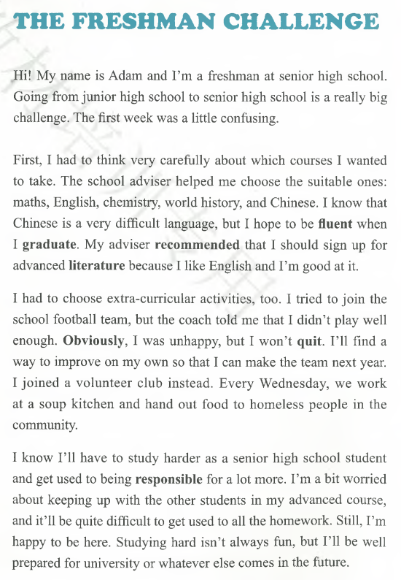
必修一P14

Slide 49
Unit 1 Reading and Thinking: The Freshman Challenges
Adam is a freshman at senior high school. Going from junior high school to senior high school is a really big challenge. The first week was a little confusing.
First, he had to think very carefully about which courses he would like to take. His teacher advised him to choose the suitable ones: maths, English, chemistry, world history, and Chinese. He knows that Chinese is a very difficult language, but he hopes to be fluent when he graduates. His teacher also recommended him to sign up for advanced literature because he is good at English.
Adam had to choose extra-curricular activities, too. He wanted to join the school football team, but the coach thought that he didn't play well enough. It was obvious that he was unhappy, but he won't quit. He will find a way to improve on his own so that he can make the team next year. He joined a volunteer club instead. Every Wednesday, they work at a soup kitchen and hand out food to homeless people in the community.
He is fully aware that he will have to study harder as a senior high school student and get used to being responsible for a lot more. He is a bit worried about keeping up with the other students in his advanced course. He finds it quite difficult to get used to all the homework. Still, he is happy to be here. Studying hard isn't always fun, but he will be well prepared for university or whatever else comes in the future.

Slide 50
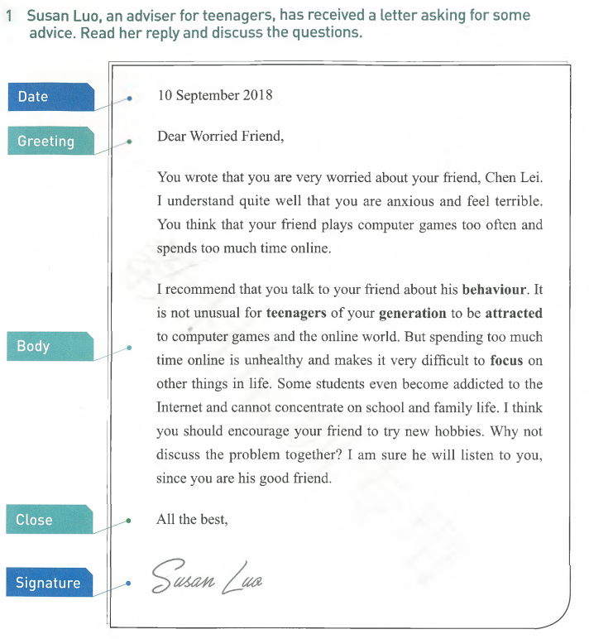
以a worried friend的口吻 写一封求助信
Dear Susan Luo，
I am a worried friend. My friend Chen Lei is addicted to playing computer games. I am so worried about him that I am writing to ask for advice.
Chen Lei used to hand in his homework on time, but now he doesn’t. He spends so much time on the Internet that he has lost interest in his lessons. As his good friend, I know it is wrong to be addicted to playing games. But I don’t how what I can do to help him. That is why I turn to you for help. Could you offer me some advice on how to drag him away from the online world？
Looking forward to your early reply.
Yours,
A worried friend
必修一P18

Slide 51
Susan Luo 写给Chen Lei的一封信
Dear Chen Lei，
I am sorry to know that you are attracted by computer games and spend a lot of time on them every day. I would like to offer you some advice.
In the technology era, get on line has become an important part of life. But if you are addicted to computer games, it is time for you to make a change. I advise you to join a club, where you can find someone who has the same interest as you, so you can follow you dream together. Besides, it is a good idea to play sports with your classmates, which can not only help you to keep fit, but also strengthen your friendship. Remember that there are so many interesting things that are well worth doing, so you should focus your attention on what is important for you.
I hope you will find my advice useful.
Yours,
Susan Luo

Slide 53
如何写英语建议信？
P1 ：了解对方的处境、表示理解、写信的目的是提出建议
P2: 为对方提出几点建议（2-3条）
P3:希望自己的建议对对方有帮助
（希望对方采纳自己的建议） 、希望建议被采纳

Slide 54
总结出写建议信的模板，常用的句子
开头
I am delighted to hear that you have difficulty with. Now I’d like to offer you some advice.
I’m sorry to hear that you have some trouble doing…. I am writing to make you some suggestions.
提出建议
I suggest/advise/recommend you should form the good habit of taking regular exercise.
I advise you to take a 20-minute walk in the park near your home.
It is a good idea to watch the Chinese teaching program on CCTV.
It is helpful to make a Chinese friend so that you can practice speaking with him or her.
You had better have a balanced diet that contain various vegetables and fruits.
You should drink plenty of water to keep fit.
结尾
I hope it will be helpful. If you need more information, just let me know.
If you have any further questions, please feel free to contact me.
If you need further information, don’t hesitate to contact me.

Slide 55
Unit 1 Teenager Life
围绕单元话题，提供写作素材，培养写作能力
介绍自己就读的高中，学校开设的课程、最喜欢的选修课、社团活动、
青少年存在的问题：不健康的生活方式（沉迷网络、缺乏体育锻炼，饮食不健康、吃零食、不按时就餐）不擅长与人交流、不适应新学校
我的理想、学的专业、最喜欢的一本书、最喜欢的老师、最崇拜的人

Slide 56
假定你是李华，你的外国网友Lisa最近给你发来一封邮件，询问你进入高中后的生活。请根据下面的写作提示，给她回复一封邮件，介绍你的高中生活。内容包括：
1.你所在的学校；2.开设的课程；3. 你的高中生活。
注意：
1. 词数100左右；2. 可适当增加细节, 以使行文连贯。
Dear Lisa,
_____________________________________________________________________________________________________________________________________________________________________________________________
Yours,
Li Hua

Slide 57
Dear Lisa,
It's great to receive your email. Knowing that you are interested in my life in senior high school. I'd like to share it with you.
I’m studying in No 2 Middle School of Linquan, Anhui Province. We learn nine subjects, namely Chinese, maths, English, politics, history, geography, physics, chemistry and biology, which are known as required courses(必修课). Besides, PE and art classes are available in our school. After class, we can join various extra-curricular activities. There are clubs for us to choose from, including running, basketball, singing, painting and cooking, which allows us to follow our interest. I am happy to have such a wonderful school life. Though I find some courses difficult, I am determined to overcome challenges to make my dream come true.
Can you tell me something about your school life? Looking forward to your early reply.
Yours,
Li Hua

Slide 58
假定你是李华，得知你的外国网友Chris不太适应高中生活。请根据下面的写作提示，给他回复一封邮件。内容包括：
1.表示理解；2. 提几点建议；3希望情况好转。
注意：1. 词数100左右；
2. 可适当增加细节, 以使行文连贯。
Dear Chris,
______________________________________________________________________________________________________________________________
Yours,
Li Hua

Slide 59
Dear Chris，
I am sorry to learn from your email that you have difficulty in adapting to your new senior high school life. I can understand well how you are feeling now. However, the situation is easy to improve if you take my advice. Here are some tips for you.
To start with, you should ask your teachers and parents for advice, who are willing to provide you with the help you need badly. Secondly, you’d better make a careful plan, which can help you to make better use of your time. More importantly, you can talk to your classmates and learn from them, especially those who have adapted to the new life quickly.
I hope you feel better and make progress in your studies.
Yours,
Li Hua

Slide 60
假定你是李华，你的外国笔友Lisa给你发来邮件，说她在新学校很难与新同学相处。请根据下面的写作提示，给她回复一封邮件。内容包括：
1. 表示理解；2. 提出几点建议；3. 希望情况好转。
注意：1.词数100左右；2.可适当增加细节，以使行文连贯。
Dear Lisa,
I am sorry to know you find it hard to fit in with your new classmates. I understand how you are feeling. Now I’d like to offer your some advice.
Actually it takes some time to adapt to a new surroundings. But if you take my advice, it will be easy for you to make new friends in your new school. First of all, always be friendly and helpful, ready to lend helping hand if someone needs your help. Secondly, you’d better talk to your classmates, which can help them know you better. Besides, it is a good idea for you to join a club, where you can find someone who shares the same interest as you. And you are likely to become good friends.
I hope you will find my advice useful.
Yours,
Li Hua

Slide 61
假定你是李华，得知你的英国网友Joe沉迷网络。请根据下面的写作提示，给他写一封电邮。内容包括：
1. 自我介绍；
2. 沉迷网络的危害；
3. 给他提出一些建议。
注意：
1. 词数100左右；2. 可适当增加细节, 以使行文连贯。
Dear Joe,
_________________________________________________________________________________________________________________________________
Yours,
Li Hua

Slide 62
Dear Joe,
I’m Li Hua, a senior high school student from China. I am sorry to know you are addicted to the Internet and your parents are worried about you. I would like to make some suggestions.
As far as I’m concerned, spending too much time in the virtual world has affected your life. Surfing the Internet in your spare time,, you are cut off from the real world. That is why you have to change our lifestyle. First, you should join a club, where you can follow your interest and make some new friends. Second, it is a good idea to play more sports with your classmates. Moreover, you’d better develop a new hobby such as reading or singing, which allows you to have fun.
The situation is easy to improve if you are willing to make a change.
Yours,
Li Hua

Slide 63
假如你叫李华。外国笔友笔友Jim给你发来邮件，说他缺乏体育锻炼，导致体重肥胖。为此他感到非常苦恼，向你发出求助。请根据下面的写作提示给他写一封建议信。内容包括：
1. 向他表示同情；2. 为他提出几点建议。
注意：1. 词数100左右；2. 可适当增加细节，以使行文连贯。
Dear Jim,
_______________________________________________________________
_______________________________________________________________

Slide 64
Dear Jim,
I know you are feeling annoyed these days because you are laughed at for being overweight. I understand how you are feeling. Now I'd like to offer some advice for you.
As we all know, being overweight may lead to some diseases. So it is necessary for you to develop a healthy lifestyle. First, you should take more physical exercise instead of staying indoors playing computer games. Second, it is a good idea to have a balanced diet that includes grain, meat, milk, fruit and vegetables to get enough energy. More importantly, you’d better play sports with your classmates in your spare time, which can help you to lose weight and develop a pleasant relationship with them.
I hope you will find my advice useful.
Yours,
Li Hua

Slide 65
Inspiring quotes:
When life gets harder, challenge yourself to be stronger.
The bigger the challenge, the bigger the opportunity for growth.
We don’t grow when things are easy; we grow when we face challenges.
We are what we repeatedly do. Excellence, then, is not an act, but a habit.
If you don’t challenges yourself, you will never realize what you can become.

Slide 66
补充话题阅读和练习
Unit 1 补充练习How to keep fit.docx
围绕单元话题进行阅读练习，为英语进行交际打下良好的基础
为写作做好语言积累
Unit 1补充练习题.docx
帮助学生形成正确的人生观、价值观，培养积极的人生态度
教会学生做人做事

Slide 67
课程标准的要求
《英语课程标准》明确了将培养英语学科核心素养作为新时期英语课程改革的目标，聚焦培养学生的语言能力、文化意识、思维品质和学习能力，以达到落实立德树人和学科育人的根本目的。英语课堂教学需要转变以传递知识和发展技能为主的教学模式，而是“以主题为引领、语篇为依托、活动为途径”的新的教学模式，推动语言、文化、思维和学习能力的整合发展，引导学生转向以意义探究、语言建构、综合运用、思维发展、文化交际、解决问题等为主要特点的学习。学生需要学习和运用语言知识和语言技能，从多种类型的语篇中获取文化知识，通过分析、论证、批判、评价等活动，理解文化内涵，比较文化异同，辨别真善美，汲取文化精华，理性表达观点，形成文化意识，提升核心素养。因此，作为教学用途的语篇并非像很多教师长期认为的那样，仅仅是词汇和语法知识的载体。

Slide 68
实践英语学习活动观，着力提高学生学用能
普通高中英语课程倡导指向学科核心素养发展的英语学习活动观和自主学习、合作学习、探究学习等学习方式。教师应设计具有综合性、关联性和实践性特点的英语学习活动，使学生通过学习理解、应用实践、迁移创新等一系列融语言、文化、思维为一体的活动， 获取、阐释和评判语篇意义，表达个人观点、意图和情感态度，分析中外文化异同，发展多元思维和批判性思维，提高英语学习能力和运用能力。

Slide 69
Unit 2 Traveling around
阅读：
人们为什么要旅行？ 为什么节假日那么多去旅行 旅行带来的好处
外国研学 国外旅行 生态旅行 旅行的经历
写作：
暑期自己的旅行计划 为外国网友推荐旅行目的地 （北京、西安、张家界）
分享自己的旅行经历

Slide 70
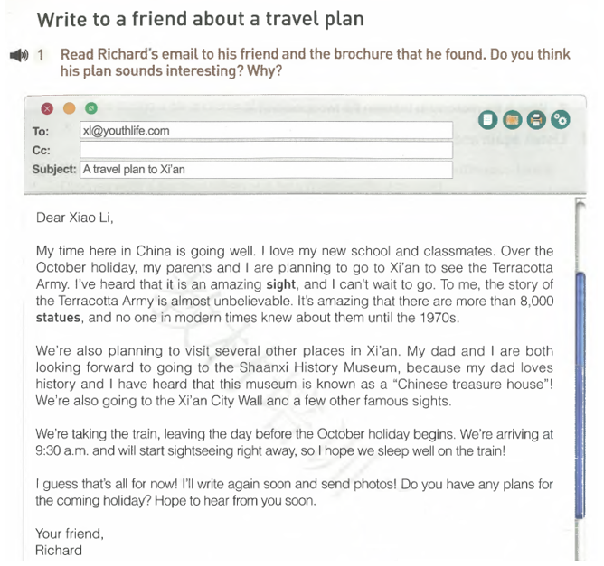
介绍暑期的旅行计划

Slide 71
Unit 3 Sports and Fitness
我们为什么要体育锻炼？ 体育锻炼的好处
体育明星的人格魅力 我最喜欢的体育活动
邀请外教参加学校体育节、邀请笔友参加排球赛
学校举办的运动会 学校举办的5公里越野大赛
介绍学校开展的体育活动 建议外教长跑
培养学生对体育运动的热爱，养成锻炼的好习惯
每天锻炼一小时 健康生活一辈子 培养健康的生活方式

Slide 72
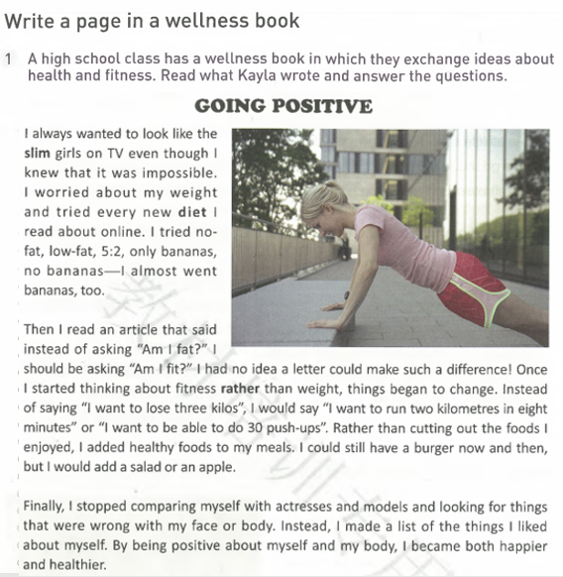
P42

Slide 73
Ⅴ. Writing: A Page in a Wellness Book
Going Positive
I always wanted to look like the slim girls on TV even though I knew that it was impossible. I worried about my weight and tried every new diet I read about online. I tried no-fat, low-fat, 5: 2, only bananas, no bananas --I almost went bananas, too.
Then I read an article that said instead of asking “Am I fat?” I should be asking “Am I fit?” I had no idea a letter could make such a difference! Once I started thinking about fitness rather than weight, things began to change. Instead of saying “I want to lose three kilos”, I would say “I want to run two kilometers in eight minutes” or “I want to be able to do 30 push-ups”. Rather than cutting out the foods I enjoyed, I added healthy foods to my meals. I could still have a burger now and then but I would add a salad or an apple.
Finally, I stopped comparing myself with actresses and models and looking for things that were wrong with my face or body. Instead, I made a list of the things I liked about myself. By being positive about myself and my body, I became both happier and healthier.
What Kayla did to lose weight
in the past.
Going Positive
How Kayla changed her way of thinking.
Kayla’s positive attitude toward herself and her good feeling.

Slide 74
The structure of a page in a wellness nook
P1: past experience
P2: changes in your life
P3: your feelings

Slide 75
某英文报最近设立一个“学生园地”，邀请同学们分享自己参加体育锻炼的经历。请根据下面的写作提示，写一篇短文。内容包括：
1. 你参加的体育项目；
2. 你的生活发生的变化；
3. 你的感受。
注意：1.词数100左右； 2.可适当增加细节，以使行文连贯。

Slide 76
One possible version:
I remember there was a time when I got sick easily. When the weather changed suddenly, I would get a bad cold and headache. Taking medicine was part of my life, which made me weak and upset.
When I went to hospital, the doctor told me that I should take physical exercise regularly to boost immune system. Since then I have made it a habit to jog in the park near my home. I also play sports with my classmates in my spare time and play badminton with my parents at weekends. Gradually my health improves and I feel much better.
Playing sports helps me stay healthy and prevents disease. It is the physical activities that make me healthy and happy.

Slide 77
（三）如何复习语法专题？
1. 挖掘网络资源，优化教学内容和学习方式
2. 发挥学生的主体性，主动构建知识
3. 为学生提供交际的语境，发展语言能力
4. 做思维导图梳理知识，构建知识网络
5. 做游戏，让学生体验学习的快乐
6. 尽量在语篇中学习语法

Slide 78
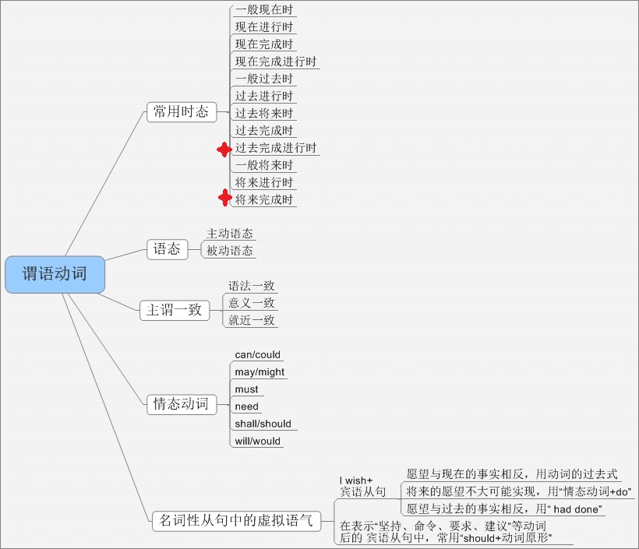

Slide 79
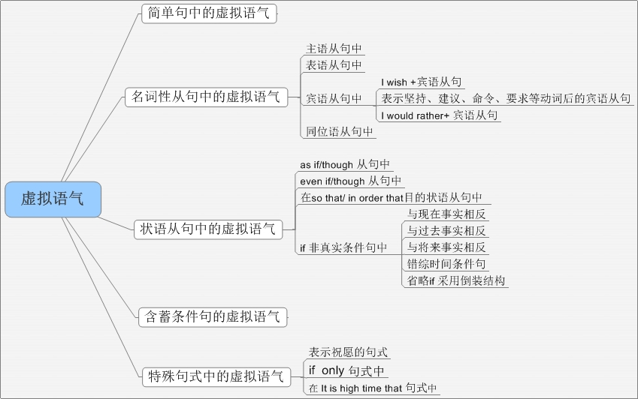

Slide 80
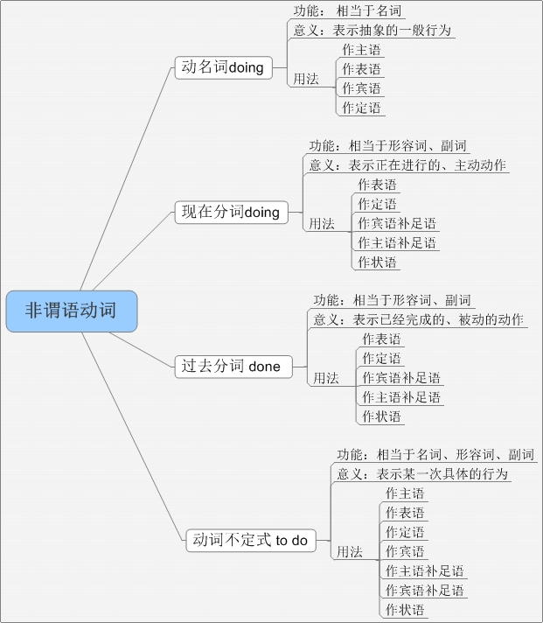
用思维导图梳理知识

Slide 81
非谓语动词考点梳理
动词不定式to do
doing
过去分词done
一、非谓语动词的种类
现在分词
动名词
二、非谓语动词的不同形式
（一）现在分词的各种形式：
一般式: 被动式: 完成式:
完成被动式:
（二）动词不定式的各种形式：
一般式: 被动式: 进行式:
完成式: 完成被动式:
完成进行式:
doing
being done
having done
having been done
to do
to be done
to be doing
to have done
to have been done
to have been doing

Slide 82
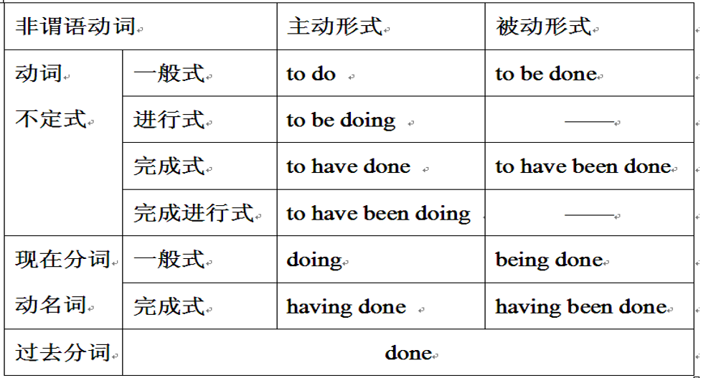

Slide 83
2023全国乙卷
Beijing is a city bridging the ancient and the modern. From Buddhist temples to museums, narrow hutong 61 royal palaces, it is home to more than 3,000 years of glorious history even down to its layout, with the city keeping its carefully 62 (build) system of ring roads.
But for all its ancient buildings, Beijing is also a place 63 welcomes the fast-paced development of modern life, with 21st-century architectural 64 (wonder) standing side by side with historical buildings of the past.
It is a distinct visual contrast (反差) that shouldn’t work, 65 somehow these two very different worlds make a good combination.66 (visit) several times over the last 10 years, I 67 (amaze) by the co-existence of old and new, and how a city was able to keep such a rich heritage(遗产) while constantly growing. As a photographer, I have spent the last two years 68 (record) everything I discovered.
The 69 (remark) development of this city, which is consciously designed to protect the past while stepping into the modern world, 70 (mean) there is always something new to discover here, and I could be photographing Beijing for the next 50 years.
to
built
that/which
wonders
but/yet
Having visited
was amazed
recording
remarkable
means

Slide 84
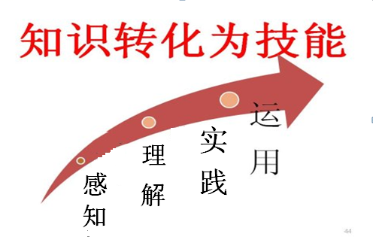

Slide 85
（四）如何提升学生的阅读能力？
考生在阅读理解方面存在的问题
1.篇章全局意识和段落间、段落中逻辑意识欠缺
2.驾驭句子的能力弱，长难句理解不精准；
3.捕捉、整合、和加工关键信息能力不足
4.归纳和概括的能力有待提高
5.不够了解高考的命题特点,没有掌握解题技巧

Slide 86
如何帮助考生提高阅读能力？
1.关注语篇，利用思维导图展示篇章结构
2.引导学生 read for mearning
3.分析文章的写作方法，弄清论点和论据
4.深入挖掘本文，发挥本文的育人价值
5.培养学生的文化意识，提升人文素养

Slide 87
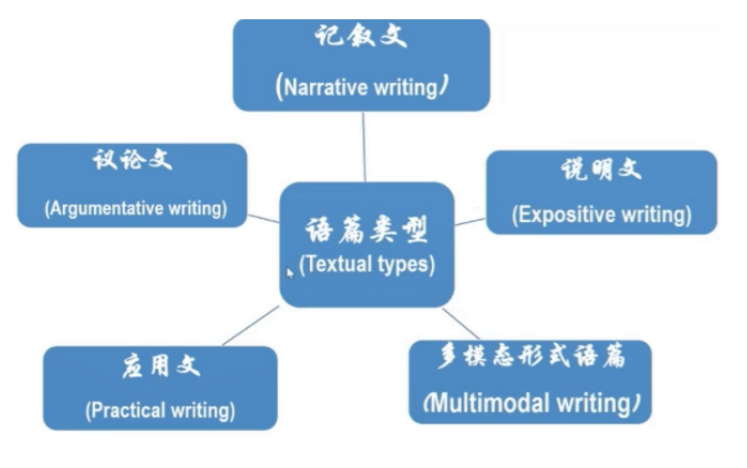

Slide 88
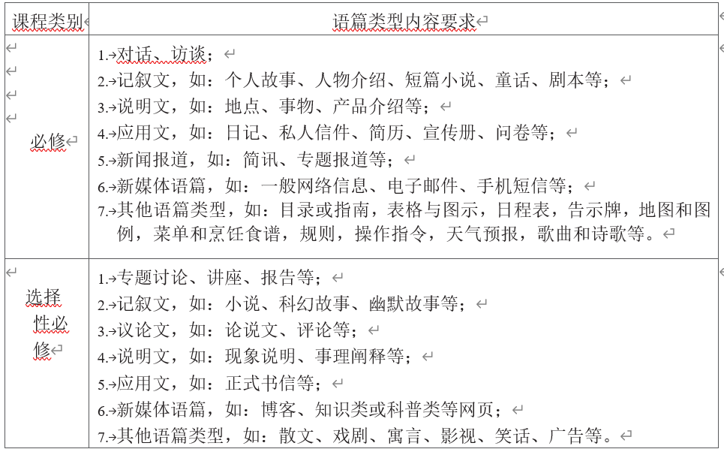

Slide 89
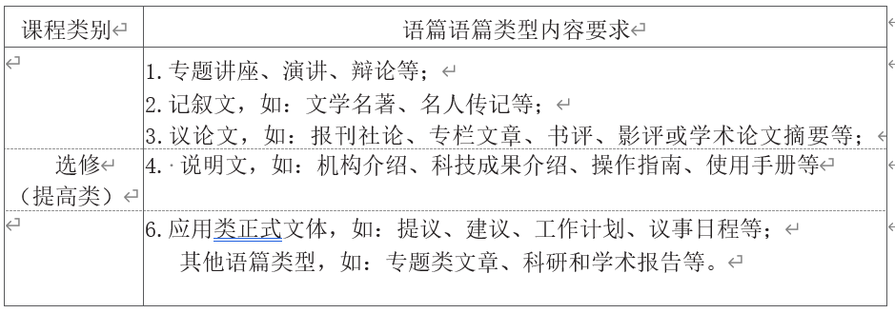

Slide 90
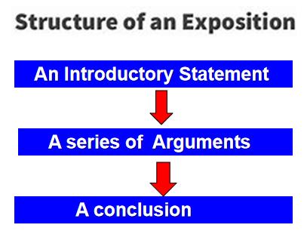
常见英语文体的结构

Slide 92
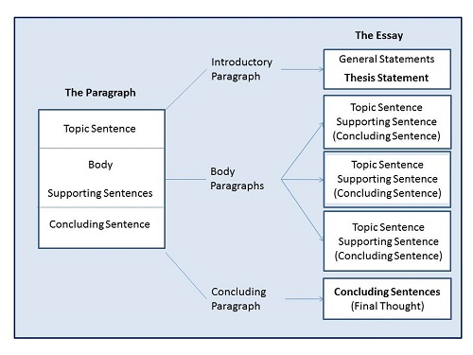

Slide 93
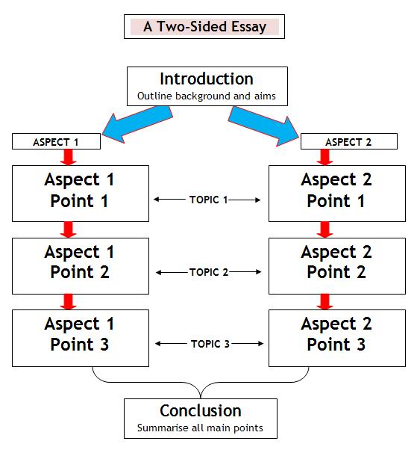
正反两种观点的议论文的结构

Slide 94
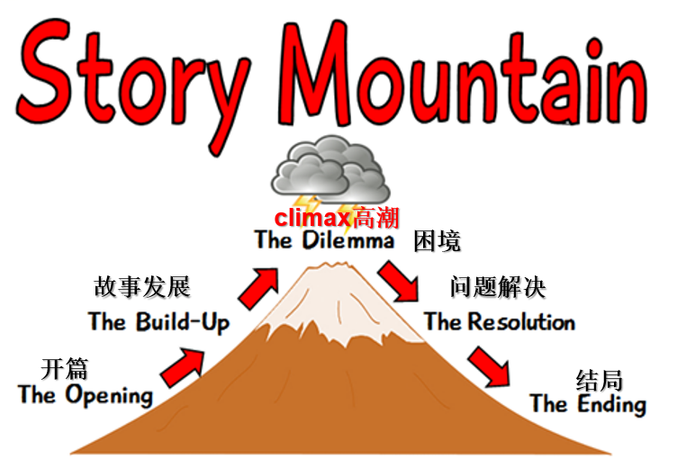

Slide 96
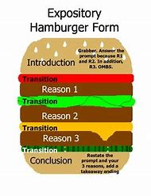

Slide 98
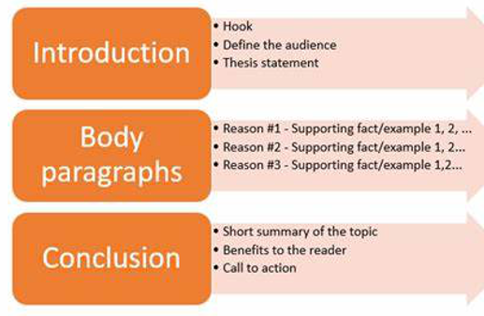
应用文的篇章结构

Slide 99
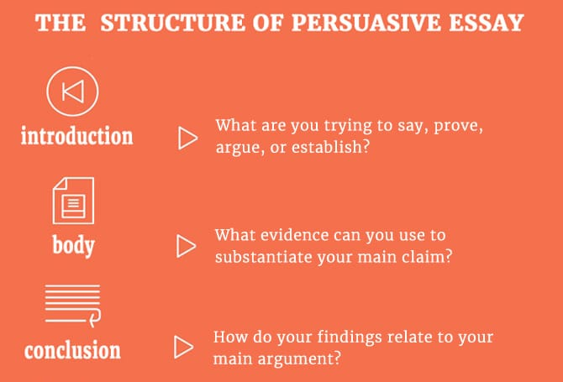
议论文的篇章结构

Slide 100
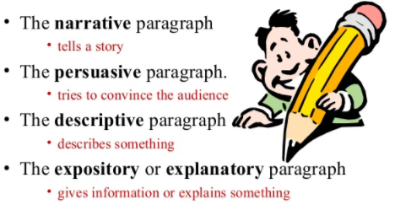
常见英语文体写作目的

Slide 101
七选五阅读的句际关系
并列关系 | 分句陈述的是同一事情的几个方面
转折关系 | 前后两句话之间是逻辑上的逆转
解释关系 | 后句对前句作解释、引申
因果关系 | 前后句间存在原因和结果之间的关
递进关系 | 能够表示在意义上进一层关系
例证关系 | 前后句的某句是为了证明另一句而举的例子
让步关系 | 使用连词“尽管”和“即使”的分句
对比关系 | 前后两个句子在意义上构成对比
条件关系 | 表示有了某种条件,才会出现某种结果
选择关系 | 分句说出两种情况,并表示要从中选择一种
顺序关系 | 根据动作或状态的先后发展顺序排列

Slide 102
7选5阅读解题注意事项
不可只看同词复现，要结合前后句逻辑
不可只看表象线索，要避免前后句重复
不可只看设空位置，要跳出段落看逻辑
不可只看上下一句，要结合段落扣主题

Slide 103
（五）如何培养学生的写作能力
1.书信类写作
2.非书信类

Slide 104
2023年新高考I、II卷
假定你是李华，外教Ryan准备将学生随机分为两人一组，让大家课后练习口语，你认为这样分组存在问题。请你给外教写一封邮件，内容包括：
1. 说明问题；
2. 提出建议。
注意：
1. 写作词数应为80个左右；
2. 请按如下格式在答题卡的相应位置作答。

Slide 105
2023年全国乙卷
学校英报组织同学们分享自己在假期中学到的新技能,请你以此为主题写一篇短文投稿。内容包括:
1. 简要描述;
2.体验和感受。
注意:
1.词数100 左右;
2.题目己为你写好。

Slide 106
2023年全国甲卷
学校举办以用英语讲中国故事为主题的征文活动，请以一位中国历史人物为题写一篇短文投稿，内容包括：
1. 人物事迹； 2. 意义； 3. 启示。
注意： 1. 词数100左右；2. 可以适当增加细节，以使行文连贯。
A Historical Figure
________________________________________________________________
________________________________________________________________
________________________________________________________________

Slide 107
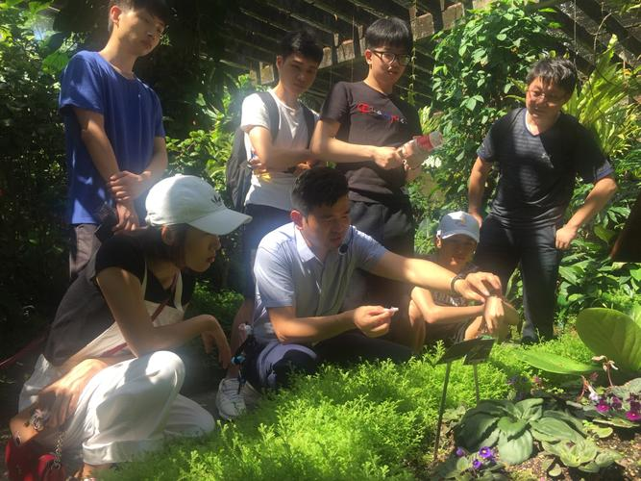
2023年1月浙江高考
上周末你参加了校学生会组织的“认识我身边的植物”活动。请为校英文报写篇报道，内容包括：
1.活动的过程；
2. 收获与感想。
注意：
1. 写作词数应为 100 左右；
2. 请按如下格式在答题纸的相应位置作答。
Getting to Know the Plants Around Us
________________________________________________________________
________________________________________________________________
________________________________________________________________

Slide 108
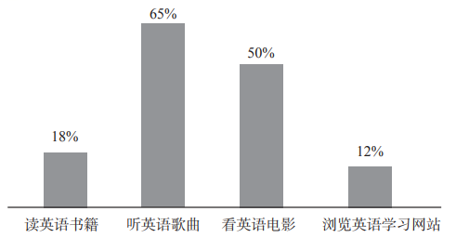
2022年全国乙卷
学校英文报正在开展以Learning English Beyond the Classroom为题的讨论。请使用图表中的调查结果写一篇短文投稿，内容包括：
1. 学习活动状况描述：
2. 简单评论;
3. 你的建议。
注意：
1. 词数100左右;
2. 短文的题目和首句已为你写好。

Slide 109
2021年全国乙卷
你校将举办英语演讲比赛。请你以Be smart online learners 为题写一篇发言稿参赛，内容包括：
1.分析优势与不足；
2.提出学习建议。
注意：1.词数100左右；2.题目和首句已为你写好。
Online learning has become an important way to study recently. _________
_________________________________________________________________________________________________________________________________________________________________________________________

Slide 110
2020年全国新高考II卷
上周末，你和同学参加了一次采摘活动。请你为班级英语角写一篇短文，介绍这次活动。内容包括： 1.农场情况; 2.采摘过程; 3.个人感受。
注意: 1.词数100左右;
2.题目已为你写好;
3.可适当增加细节，以使行文连贯。

Slide 111
2020全国新高考I卷
假定你是李华，上周日你校举办了5公里越野赛跑活动。请你为校英文报写一篇报道，内容包括:
1.参加人员;
2.跑步路线:从校门口到南山脚下;
3.活动反响。
注意: 1.词数为100左右; 2.可适当增加细节, 以使行文连贯。

Slide 113
The structure of a news report(新闻报道类文体的结构)
Summary
who
what
Process when
where
why
how
Process
comments/thoughts

Slide 114
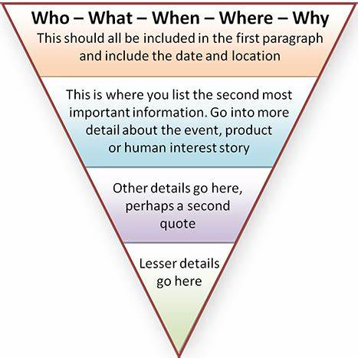

Slide 115
1. 应用文写作教学策略
1.系统指导不同类型的写作技巧
2.先读后写，引导学生学会仿写
3.根据写作提纲，确定内容要点
4.开放部分的合理与可读

Slide 116
英语写作训练的素材
1.写校园生活
2. 写热点时事
3. 关注传统中国文化
4. 看图写作
5. 读写结合（观后感 、读后感）
6. 仿写
7. 指导学生写作方法和技巧

Slide 117
应用文写作训练的体裁
安慰信
道歉信
感谢信
告知信
建议信
求助信
申请信
推荐信
投诉信
邀请信
咨询信
祝贺信
通知
广告
海报
征文
演讲稿
发言稿
倡议信
新闻报道
招募启示
非书信类
书信类应用文

Slide 118
2. 如何引导学生写好读后续写

Slide 119
2023年新高考I卷读后续写
When I was in middle school, my social studies teacher asked me to enter a writing contest. I said no without thinking. I did not love writing. My family came from Brazil, so English was only my second language. Writing was so difficult and painful for me that my teacher had allowed me to present my paper on the sinking of the Titanic by acting out a play, where I played all the parts. No one laughed harder than he did.
So, why did he suddenly force me to do something at which I was sure to fail? His reply: “Because I love your stories. If you’re willing to apply yourself, I think you have a good shot at this.” Encouraged by his words, I agreed to give it a try.
I chose Paul Revere’s horse as my subject. Paul Revere was a silversmith(银匠) in Boston who rode a horse at night on April 18, 1775 to Lexington to warn people that British soldiers were coming. My story would come straight from the horse’s mouth. Not a brilliant idea, but funny; and unlikely to be anyone else’s choice.
What did the horse think, as he sped through the night? Did he get tired? Have doubts? Did he want to quit? I sympathized immediately. I got tired. I had doubts. I wanted to quit. But, like Revere’s horse, I kept going. I worked hard. I checked my spelling. I asked my older sister to correct my grammar. I checked out a half dozen books on Paul Revere from the library. I even read a few of them.
When I handed in the essay to my teacher, he read it, laughed out loud, and said, “Great. Now, write it again.” I wrote it again, and again and again. When I finally finished it, the thought of winning had given way to the enjoyment of writing. If I didn’t win, I wouldn’t care.

Slide 120
When I was in middle school, my social studies teacher asked me to enter a writing contest. I said no without thinking. I did not love writing. My family came from Brazil, so English was only my second language. Writing was so difficult and painful for me that my teacher had allowed me to present my paper on the sinking of the Titanic by acting out a play, where I played all the parts. No one laughed harder than he did.
So, why did he suddenly force me to do something at which I was sure to fail? His reply: “Because I love your stories. If you’re willing to apply yourself, I think you have a good shot at this.” Encouraged by his words, I agreed to give it a try.
I chose Paul Revere’s horse as my subject. Paul Revere was a silversmith(银匠) in Boston who rode a horse at night on April 18, 1775 to Lexington to warn people that British soldiers were coming. My story would come straight from the horse’s mouth. Not a brilliant idea, but funny; and unlikely to be anyone else’s choice.
What did the horse think, as he sped through the night? Did he get tired? Have doubts? Did he want to quit? I sympathized immediately. I got tired. I had doubts. I wanted to quit. But, like Revere’s horse, I kept going. I worked hard. I checked my spelling. I asked my older sister to correct my grammar. I checked out a half dozen books on Paul Revere from the library. I even read a few of them.
When I handed in the essay to my teacher, he read it, laughed out loud, and said, “Great. Now, write it again.” I wrote it again, and again and again. When I finally finished it, the thought of winning had given way to the enjoyment of writing. If I didn’t win, I wouldn’t care.
have a chance to succeed in sth.

Slide 121
A few weeks later, when I almost forgot the contest, there came the news. _____________ ____________________________________________________________________________________________________________________________________________________________________________________________________________________________________
I went to my teacher’s office after the award presentation. __________________________
____________________________________________________________________________________________________________________________________________________________________________________________________________________________________

Slide 122
梳理故事情节和人物特点
had difficulty in writing
enter a writing contest
wrote +read books
handed in +rewrote
painful
negative
positive
eager to improve
enjoy
prize award ceremony
thank him for encouragement
thankful
appreciative

Slide 123
A few weeks later, when I almost forgot the contest, there came the news. _____________ ____________________________________________________________________________________________________________________________________________________________________________________________________________________________________
I went to my teacher’s office after the award presentation. __________________________
____________________________________________________________________________________________________________________________________________________________________________________________________________________________________
1 What was the new?
I won a prize.
2. Who told the author news?
My social studies teacher.
where how
3 When+ where was the award ceremony held?
How did I feel?
My teacher?
1. What did I say to my teacher?
2. How did my teach respond?
Encouragement +expectation.
3. How did the experience influence the author?
Theme?

Slide 124
One possible version
A few weeks later, when I almost forgot the contest, there came the news. I was informed that I won the first prize in the writing contest and that there would be an award presentation in two days. I was so happy to hear the news that I immediately shared it with my teacher. “I knew you would win! I am proud of you. You made it!” he said excitedly. Then came the big day. When I was invited to the stage to receive the award, I expressed my thanks to my teacher. I said, “It’s you who make me fall in love with writing, my social studies teacher. Without your recognition and guidance, I couldn’t have written this article. Again thank you very much!”
I went to my teacher’s office after the award presentation. My teacher was waiting for me. Holding my hands, he said “Congratulations! You are a good writer, so keep writing.” “You know I didn’t like writing before, but now I am crazy about it! I will try my best to create good works.” I said seriously. Since then, I have written many good works and now I am a famous writer. I owe my success to my social teacher who is a beacon in my life on the road to writing.

Slide 125
Another possible version
When I almost forgot the contest, the news came. It was another ordinary social studies class. My teacher entered the classroom with a big smile on his face. He looked straight at me, “Listen, guys, good news for you. You won first place in the writing contest. Make preparations for the award presentation to be held next Monday.” I was frozen, unable to believe what he said. No sooner had he finished than the whole class broke into thunderous applause. During the award presentation, I couldn’t find my teacher when I was on stage, which made me upset.
I went to the teacher’s office after the award presentation. “Congratulations, boy!”, he congratulated me the moment he noticed me. I burst into tears, “Thank you, sir. Without you, I couldn’t have won the prize.” He stepped forward, patted me on the shoulder, and said softly, “Believe yourself. You will definitely become a good writer one day.” Now, twenty years passed. Every time someone asked about my key to becoming a writer, I would owe my writing achievements to my social studies teacher. It was his encouragement that pushed me to become a successful writer.

Slide 126
When I almost forgot the contest, the news came. One day when I was chatting with mom, I received a call, saying that I won second prize in the writing competition and inviting me to attend the award presentation two days later. I was totally shocked. My mom who overheard my phone hugged me tightly and kissed me, excited tears streaming down her cheeks. She bought me new clothes and took me to do my hair the next day. When I stepped on stage, a woman teacher awarded the medal to me and shook hands with me. Among the audience, I found my social studies teacher, clapping hands and laughing so loud.
I went to the teacher’s office after the award presentation. With tears welling up, I said emotionally, “Sir, thank you so much. It’s you who first believe I can write well. Without your encouragement...” I stuttered and broke into tears. He smiled, saying “You should thank yourself. Your hard work and persistence paid off. Keep on writing and you will become a great writer.” Though it’s hard to learn a second language, I never stopped trying and became a writer at last. A teacher’s encouragement made a big difference.

Slide 127
（六）如何提升学生的思维品质？

Slide 128
在做高考完形填空和阅读理解题时，针对那些话题新颖，内容时尚，有助于培养学生思维品质的语篇，我们组织学生进行简单的讨论后，布置写作任务。例如：2022年新高考II卷的完形填空讲述了Jessica和丈夫在环球旅行时，为出远门的人当看房人。他们不仅节省了住宾馆的费用，还能照顾主人留下的宠物，找到居家的感觉。我们可以让学生围绕“What do you think of house sitting while traveling?”进行80-100词的英语写作。
One possible version：
I think house sitting is a great way to travel around the world. It allows travelers to stay in a stranger’s house during their trip. By keeping the house clean and feeding the pets left behind by the owners, travelers can feel at home although they are far away from home. It can also help travelers to save money because they don’t have to pay for the accommodation. Since it is both fun and economical, I am sure this way of traveling will become more and more popular.
引导学生先使用主题句表明自己的观点，然后用事实细节支撑自己的观点。这样写出来的文章观点鲜明，具有逻辑性。坚持读写训练相结合，使写作训练常态化，帮助学生养成勤于思考的好习惯，有利于培养学生的创新精神，提升学生的思维品质。同时，鼓励学生分享个人观点，勇于表达思想，培养创新精神。

Slide 129
五、复习课教学案例分享

Slide 130
以落实核心素养为目的的英语教学
英语学科核心素养
学习能力
以语篇为载体
思维品质
以教学活动为阶梯
文化意识
以探究主题意义为目的
语言能力

Slide 131
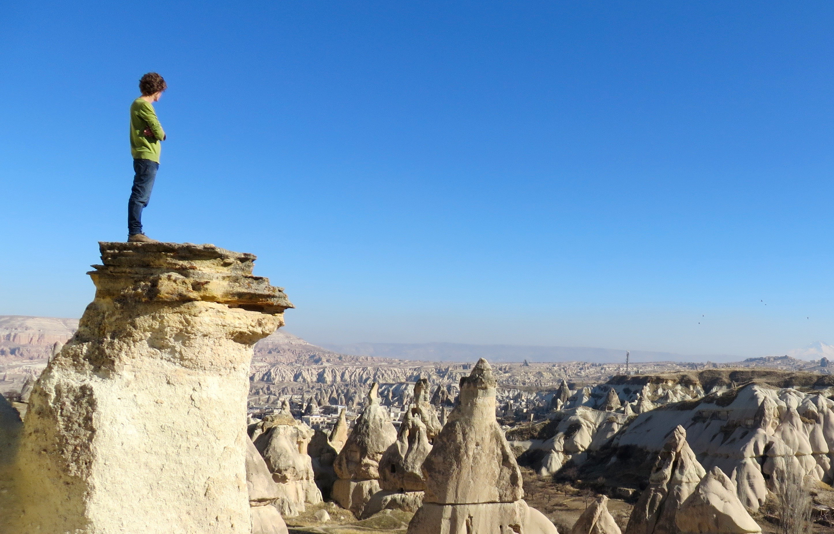
Where you stand will determine what you will see.
Whom you stand with will determine what you hear.
What you see and hear will determine what you say
and how you act.

Slide 132
